Slide 1





World AIDS Day campaign
Let’s start with the facts:
Known concept within the HIV community, yet still rather unknown to the general public.
³
+40 years of HIV discovery
~ 18.000 People Living
with HIV in Belgium ¹
41% PLWHIV are asking
for less stigma ²
³
³
¹ Sciensano (2024), Epidémiologie du VIH en Belgique. Situation au 31 décembre 2023.
² HIV plan. Pillar 4: Quality of life. https://hiv-plan.be/pillars/pillar-4-quality-of-life/. Accessed on 09/2025.
³ aidsmap. Undetectable viral load and HIV transmission. https://www.aidsmap.com/about-hiv/undetectable-viral-load-and-hiv-transmission. Accessed on 09/2025. RE: ViiV Healthcare srl/bv Avenue Fleming 20, 1300 Wavre Belgium | NP-BE-HVU-PPT-250001 September 2025
Gilead Sciences BV/SRL - Park Lane, Culliganlaan 2D, 1831 Diegem | BE-UNB-1676 – September 2025
MSD Belgium BV/SRL, Vorstlaan 25-1170 Brussel | BE-NON-02627 - Date of last revision: 09/2025
³
HIV: human immunodeficiency virus; PLWHIV: People living with HIV; AIDS: Acquired Immunodeficiency Syndrome; N=N: Niet meetbaar = Niet overdraagbaar; i=i: Indétectable = Intransmissible

Slide 2







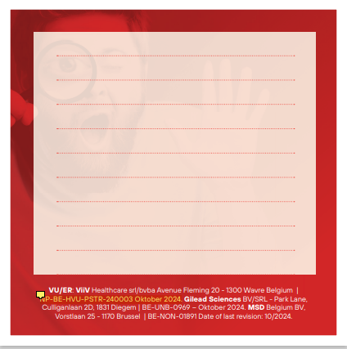
World AIDS Day campaign: Share your feedback!
Three questions we would like your thoughts on today:
What does World AIDS Day mean to you?
On World AIDS Day, which message should we focus on?
Where would you like to see a World AIDS Day campaign?
Let us know here!
RE: ViiV Healthcare srl/bv Avenue Fleming 20, 1300 Wavre Belgium | NP-BE-HVU-PPT-250001 September 2025
Gilead Sciences BV/SRL - Park Lane, Culliganlaan 2D, 1831 Diegem | BE-UNB-1676
MSD Belgium BV, Vorstlaan 25-1170 Brussel | BE-NON-02627 - Date of last revision: 09/2025

